Slide 1
SOFT 252 Assignment
Mike Jones - 10020665
Wing Chau - 10563222
Radu-Adrian Marcu - 10528506

Slide 2
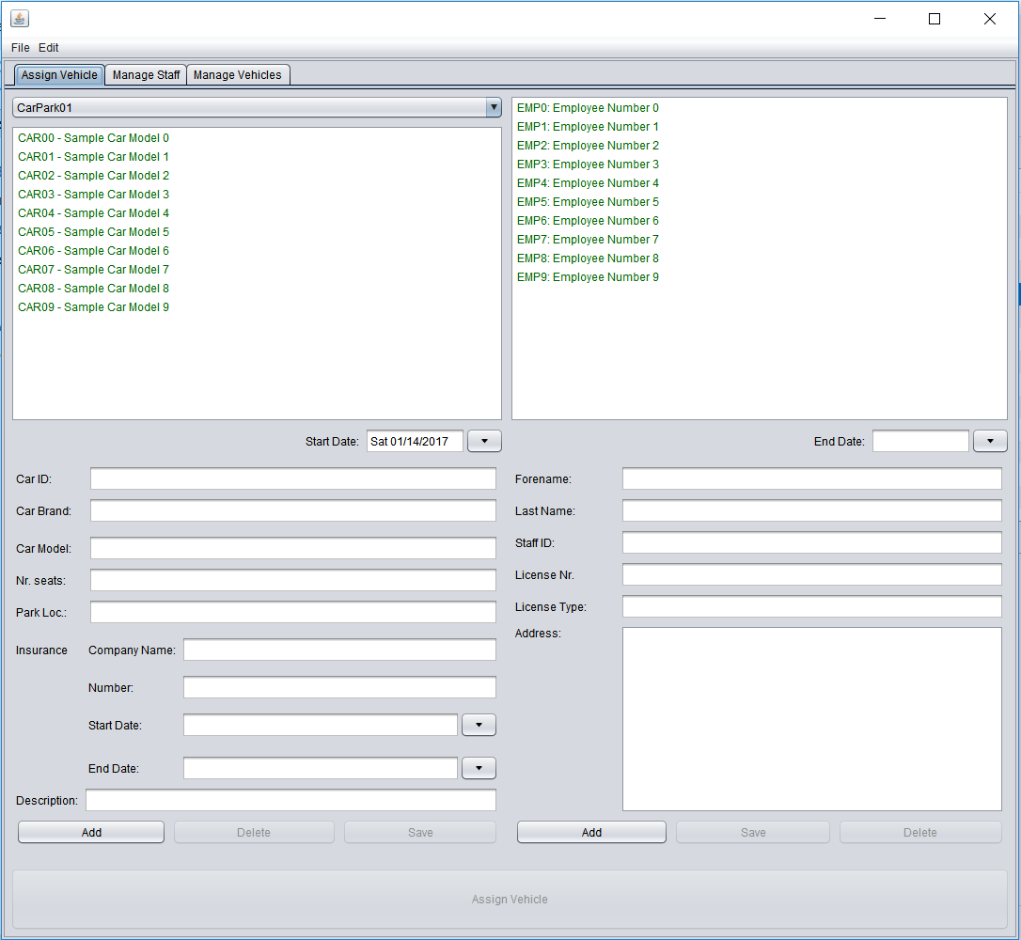
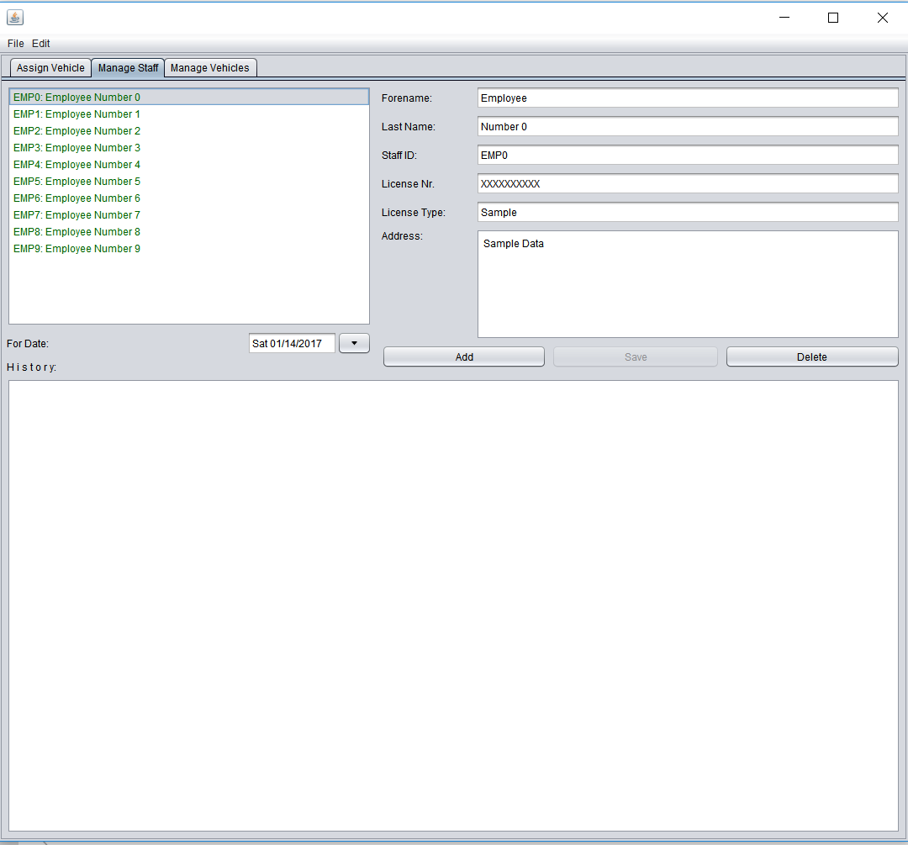
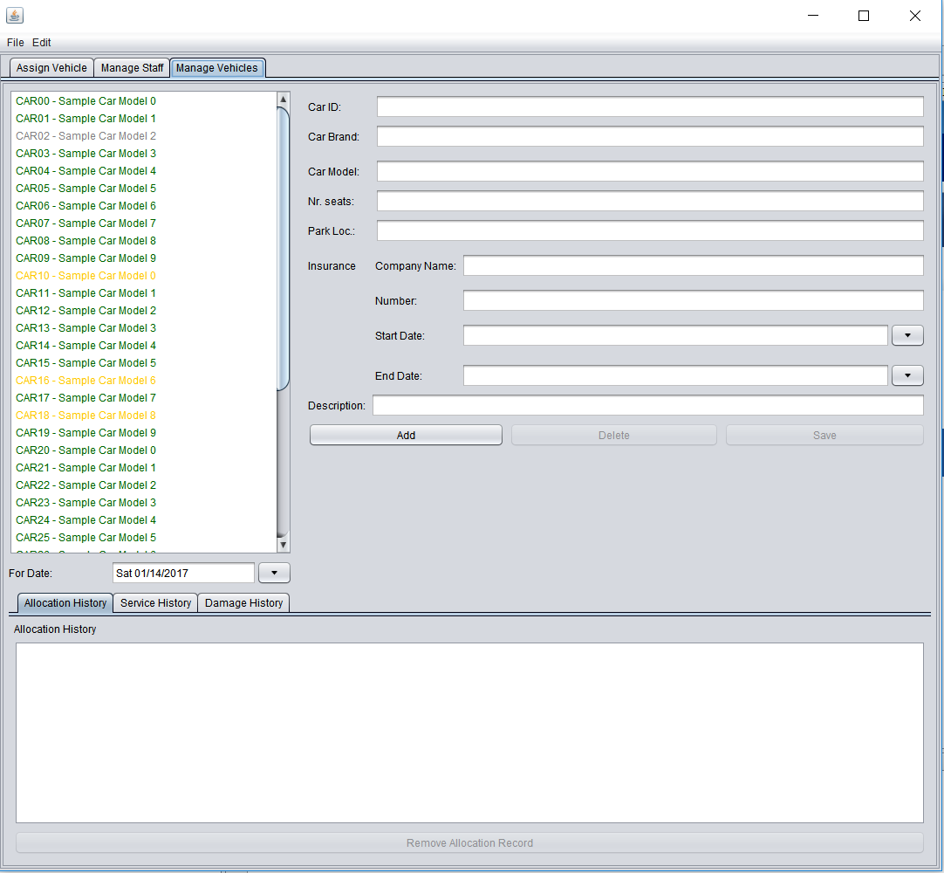
User Interface

Slide 3
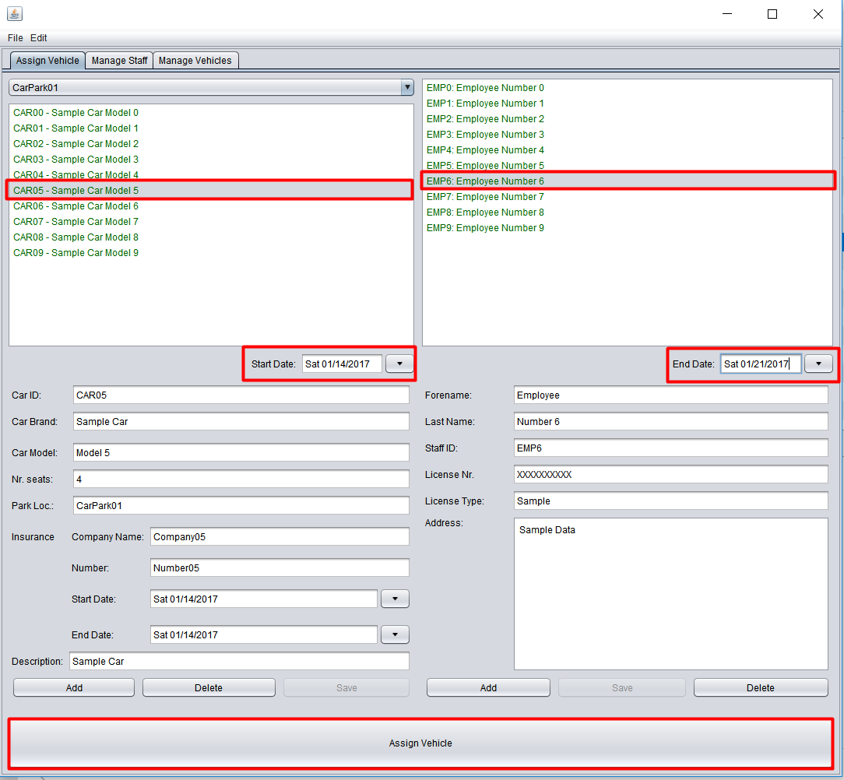
Assigning vehicles
Select an available car
Select a staff member
Select at least a ‘start date’
Select an ‘end date’ – optional for long term allocation
Click “Assign Vehicle”

Slide 4
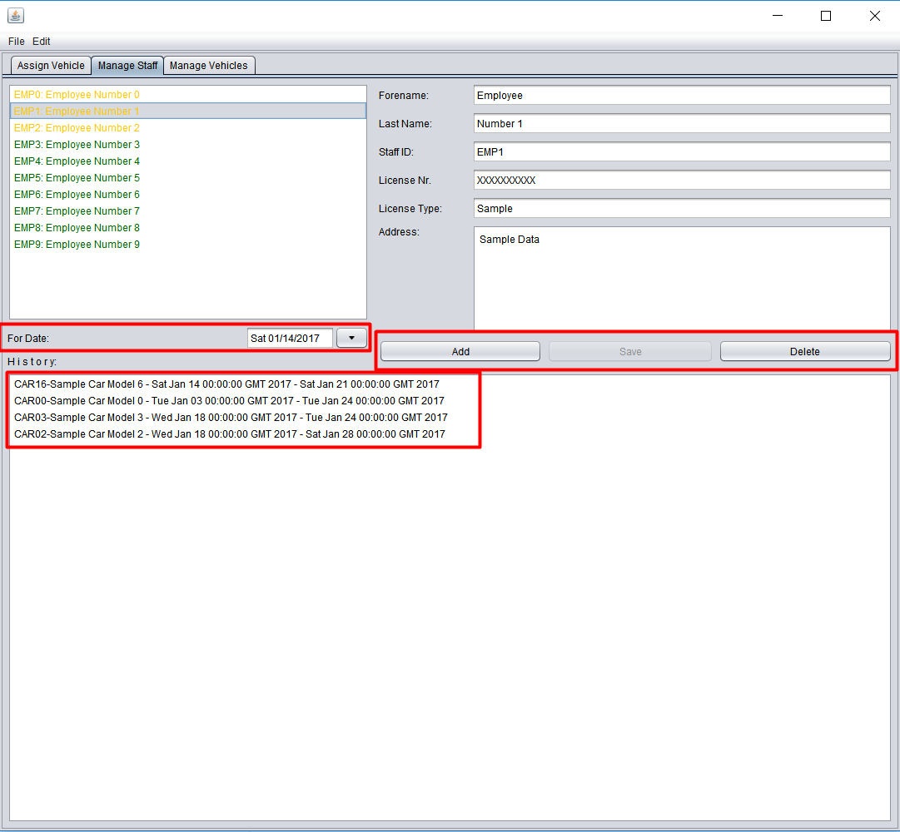
Managing employees
Allows the managing of staff members by:
Checking availability for a specific date
Adding / Deleting / Editing current staff members
Viewing allocation history
Note: Staff members that currently have for the selected date a car allocated, will be marked by yellow text.

Slide 5
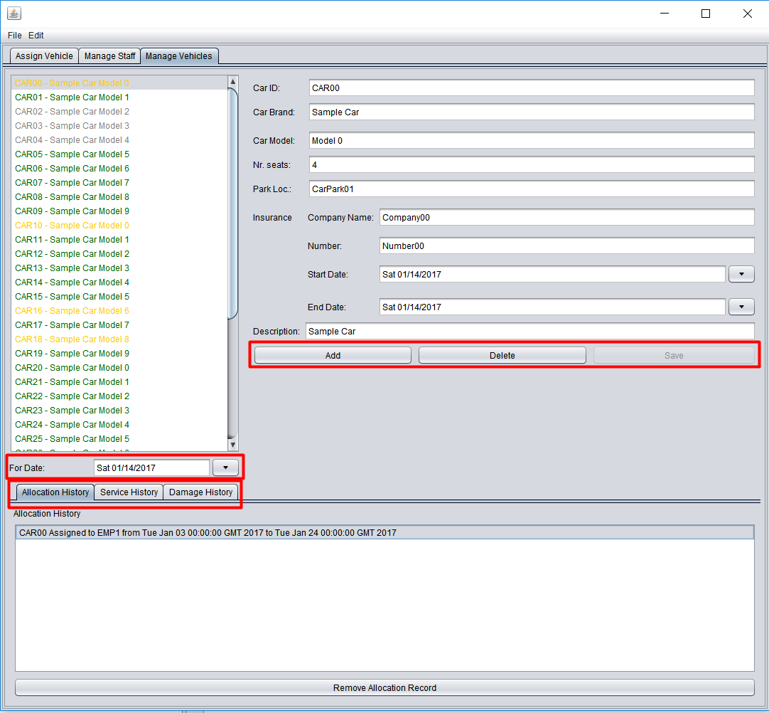
Managing vehicles
Allows the managing of registered vehicles by:
Adding / Deleting / Editing
Viewing of Allocation / Service / Damage history
Checking availability of a vehicle by selecting a date
Green – available
Yellow – allocated
Grey – in service
Red - damaged

Slide 6
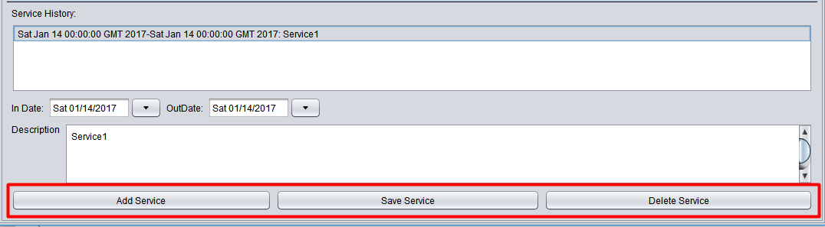
Managing service history of a vehicle
Allows management and tracking of service history by:
Viewing past and future service appointments
Adding / Editing / Deleting a service record
If a car has a service appointment pending for the selected date, the vehicle will be marked with yellow text

Slide 7
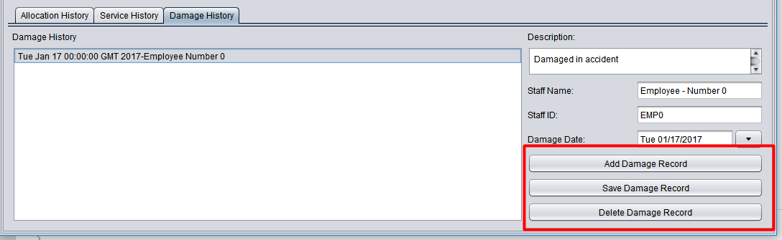
Managing damage history of a vehicle
Allows management and tracking of damage history by:
Viewing past and future accidents
Adding / Editing / Deleting a damage record
If a vehicle is unavailable due to current accidents, it will be marked by red text

Slide 8
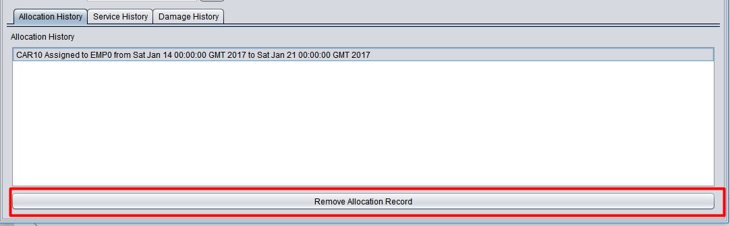
Managing allocation history of a vehicle
Allows management and tracking of allocation history by:
Viewing past and future allocations
Cancelling an allocation record
If a vehicle is allocated for the selected date, it will be marked by yellow text

Slide 9
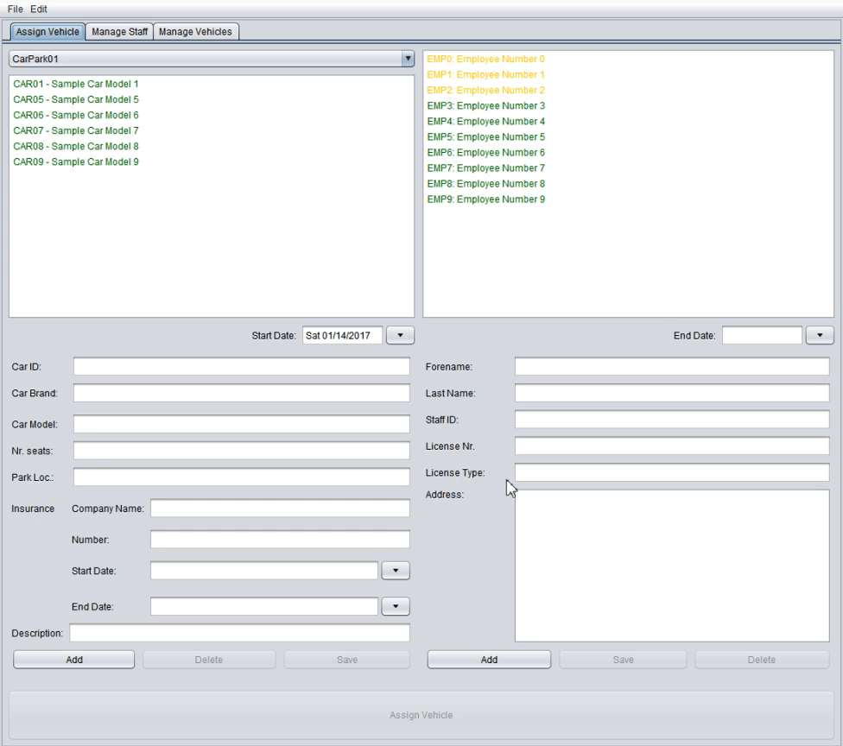
Showcase

Slide 10

Project development / progression
Version Control System
Collaboration
Storing versions (properly!)
Restoring previous versions
Understand what happened
Backup

Slide 11
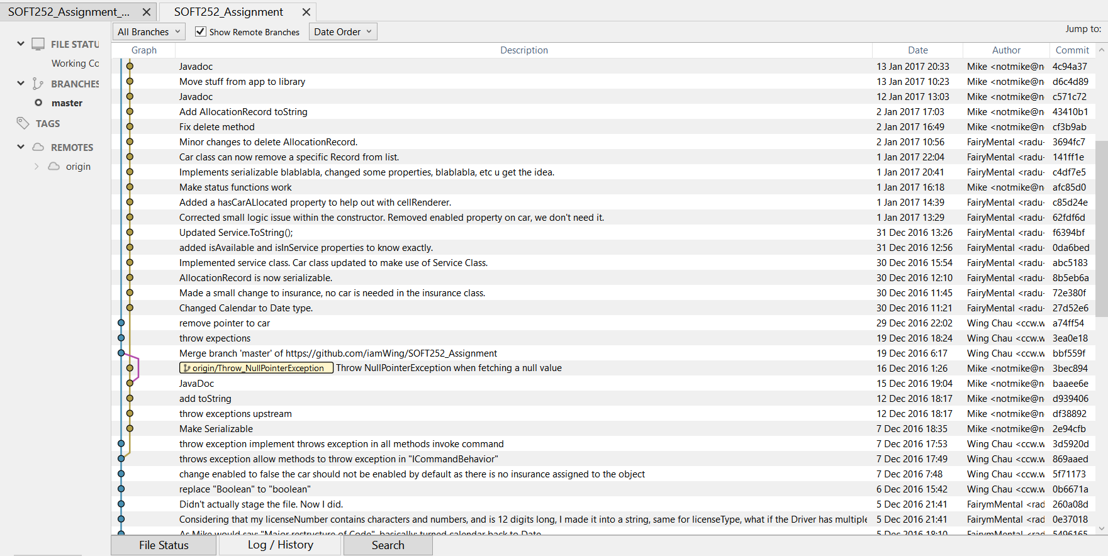
SOFT252_Library

Slide 12
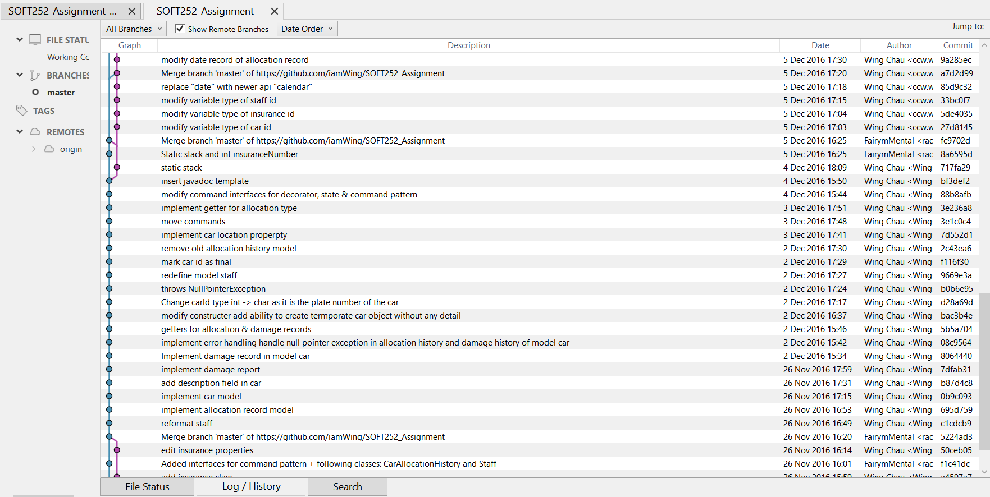
SOFT252_Library

Slide 13
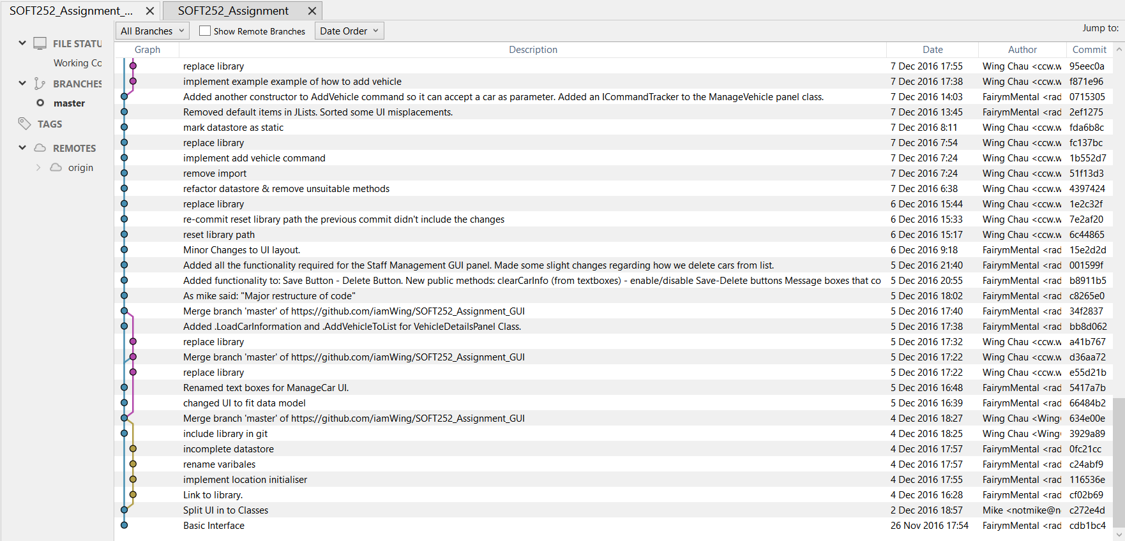
SOFT252_GUI

Slide 14
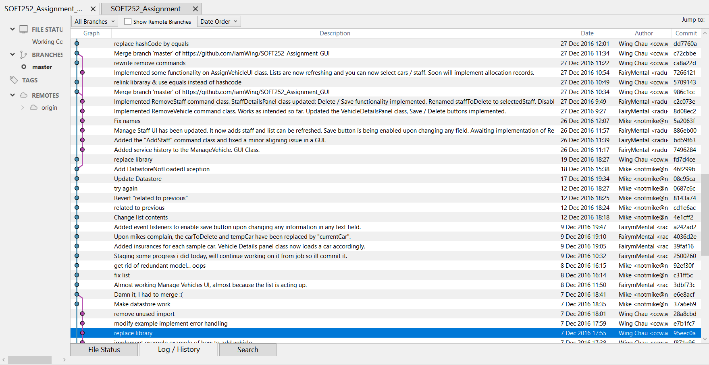
SOFT252_GUI

Slide 15
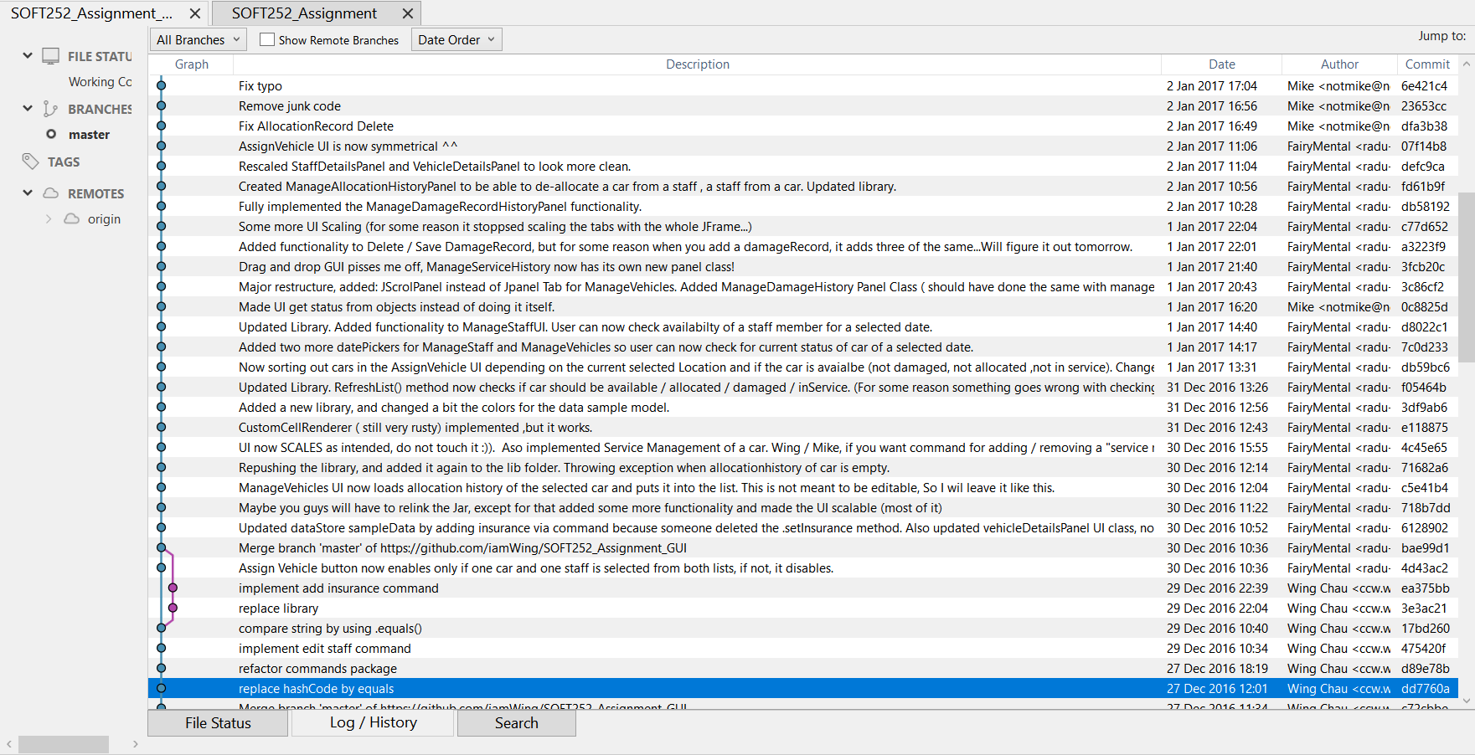
SOFT252_GUI

Slide 16
Good programming practices
Object oriented design
Modular Software design
Test driven development
Auto –generated documentation
Easy to read code (Comments / indents / etc.)
Version Control system used accordingly
One repository for each project
Open Communication (Whatsapp group conversation and detailed commit descriptions)

